Slide 1
UNIT IV – SDN Application and Use Case
UNIT I – SESSION 1
SESSION 4
  SDN in Other Environments
  Wide Area Networks.
  Service Provider and Carrier Networks
  Campus Networks
  Hospitality Networks
  Reference: Ref. 1, Ch.8.1, 8.2, 8.3, 8.4

Slide 2
Wide Area Networks (WAN)
WANs - used to connect remote islands of networks, such as connecting geographically dispersed LANs at different offices that are part of the same enterprise or organization.
Non-Ethernet technologies to facilitate this WAN connectivity, includes:
Leased line. These point-to-point connections were used in the early days of networking and were very expensive to operate.
Circuit switching. Dialup connections are an example of this type of connectivity, which had limited bandwidth but was also very inexpensive.
Packet switching. Carrier networks at the center carried traffic from one endpoint to another using technologies such as X.25 and Frame Relay.
Cell relay. Technologies such as ATM, featuring fixed cell sizes and virtual circuits, are still used today.
Cable and digital subscriber loop (DSL). These technologies play a key role in bringing WAN connectivity to the home.

Slide 3
SDN applied to WAN
SDN controller - access to global knowledge, runs on a high-performance server,
compute optimal paths more quickly and more reliably than the traditional distributed approach.
Pre-SDN technologies attempt to enable optimal routing decisions
Network monitoring and traffic management applications—for example, sFlow and NetFlow— collect the necessary information so that a network management system can make optimal routing decisions.
MPLS-TE uses traffic engineering mechanisms to choose optimal paths for MPLS label switched paths (LSPs). Packets are forwarded along this path by intermediate routers that route the packets by a preassigned mapping of ingress label-port pairs to egress label-port pairs. An LSP is sometimes referred to as an MPLS tunnel.
The path computation element (PCE)-based architecture determines optimal paths between nodes based on a larger set of network-loading conditions than may be considered in simple best path analysis such as IS-IS distributed approach

Slide 4
Example: MPLS LSPs in the Google WAN
Google describes how its pre-SDN WAN solution handles the case of a failed link.
The link labeled Best route on the right in the figure goes down. When a link goes down and the network needs to re-converge, all the LSPs try to reroute. This process is done autonomously by the routers along the path using the Resource Reservation Protocol (RSVP) to establish the path and reserve the bandwidth. The problem is that it is not known which LSP will be the last to reroute in any given scenario.
Figure shows how an SDN system with a centralized controller containing knowledge of all possible routes and current available bandwidth can address this problem much more efficiently.
The computation of an optimal solution for mapping the LSPs to the remaining network can be made once and then programmed into the devices.
This SDN-based solution is deterministic in that the same result will occur each time.
Google has been at the forefront of SDN technology since its outset, and the company has made use of the technology to its advantage in managing its WAN networks.

Slide 5
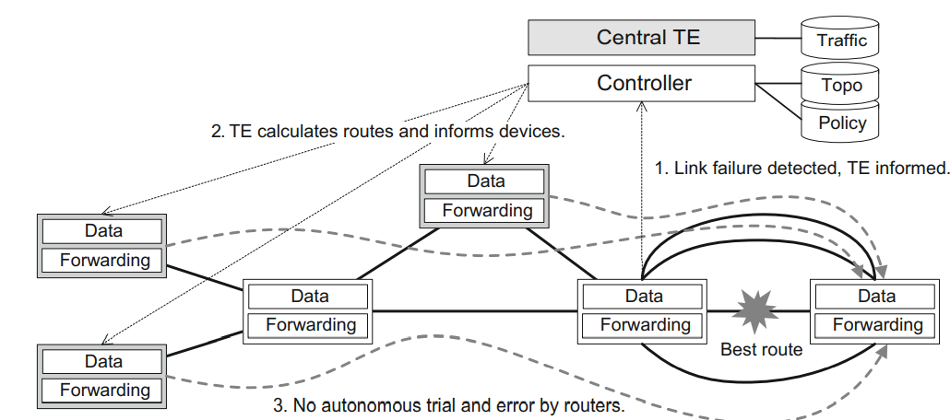
Example: MPLS LSPs in the Google WAN
Google has connected its data centers using OpenFlow switches connected to a controller designed with the features.
The values that Google has realized from its conversion to OpenFlow in the WAN are:
  Lower cost of managing devices
  Predictable and deterministic routing decisions in the case of failover
  Optimal routing decisions based on bandwidth and load

Slide 6
Service Provider (SP) and Carrier Networks
Service provider (SP) and carrier networks are wide area in nature and are sometimes referred to as backhaul networks, since they aggregate edge networks, carrying huge amounts of data and voice traffic across geographies, often on behalf of telecommunications and Internet service providers (ISPs).
Examples of service providers and carriers are Verizon, AT&T, Sprint, Vodafone, and China Mobile.
SPs are responsible for taking network traffic from one source, passing it throughout the SP’s network, and forwarding it out the remote network edge to the destination.
Thus, the packets themselves must cross at least two boundaries.
When more than one SP must be traversed, the number of boundaries crossed increases.
Traffic coming into the service provider’s network is typically marked with specific tags for VLAN and priority.

Slide 7
Service Provider (SP) and Carrier Networks
The boundaries that traffic must cross are often referred to as customer edge (CE) and provider edge (PE).
The network to-network interface (NNI) is the boundary between two SPs.
Since the NNI is an important point for policy enforcement, it is important that policy be easily configurable at these boundaries.
(See Figure) The original packet as it emanates from the source device is unencapsulated.
The packet may acquire a VLAN tag as it passes through the CE (probably provided by the ISP).
When the packet passes through the PE, it may be encapsulated using a technology such as PBB, or it may be tagged with another VLAN or MPLS tag.
When the packet exits the provider network and passes through the other PE on the right, it is correspondingly either decapsulated or the tag is popped and it is then passed into the destination CE network.

Slide 8
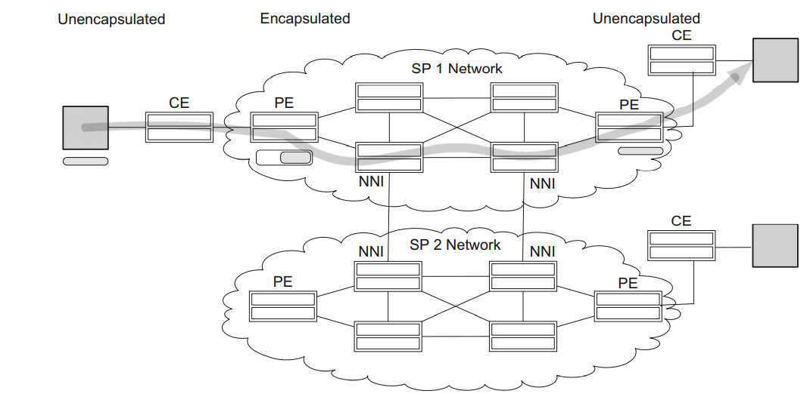
Service Provider Environment
If the customer packets were directed to a destination on the SP2 network, they would traverse such an NNI boundary.
Policies related to business agreements between the SP1 and SP2 service providers would be enforced at that interface

Slide 9
SDN Applied to SP and Carrier Networks
Monetization. This refers to the ability to make or save money by using specific techniques and tools.
SDN is promoted as a way for providers and carriers to monetize their investments in networking equipment by increasing efficiency, reducing the overhead of management, and rapidly adapting to changes in business policy and relationships.
Ways in which SDN can help improve monetization for providers and carriers are
(1) bandwidth management,
(2) CAPEX and OPEX savings, and
(3) policy enforcement at the PE and NNI boundaries.
SDN exhibits great agility and the ability to maximize the use of existing links using traffic engineering and centralized, network-wide awareness of state, allows changes to be made easily and with improved ability to do so with minimal service interruption.
This facilitates the profitable use of bandwidth as well as the ability to adapt the network to changing requirements related to customer needs and service-level agreements (SLAs).

Slide 10
Ways in which SDN can Reduce costs
First, there are CAPEX savings. The cost of white-box SDN devices is appreciably lower than the cost of comparable non-SDN equipment.
This may be due to bill-of-materials (BOM) reduction as well as the simple fact that the white-box vendors are accustomed to a lower-margin business model.
The BOM reductions derive from savings such as reduced memory and CPU costs due to the removal from the device of so much CPU- and memory-intensive control software.
Second, there are reduced OPEX costs, which come in the form of reduced administrative loads related to the management and configuration of the devices.

Slide 11
Campus Networks
Campus networks are a collection of LANs in a concentrated geographical area.
Usually the networking equipment and communications links belong to the owner of the campus.
This may be a university, a private enterprise, or a government office, among other entities.
Campus end users can connect through wireless access points (APs) or through wired links.
They can connect using desktop computers, laptop computers, shared computers, or mobile devices such as tablets and smartphones.
The devices with which they connect to the network may be owned by their organization or by individuals.
Furthermore, those individually owned devices may be running some form of access software from the IT department, or the devices may be completely independent.

Slide 12
Networking Requirements pertaining to Campus Networks
(1) Differentiated levels of access
Various types of users in the campus will require different levels of access.
  Day guests should have access to a limited set of services, such as the Internet.
  More permanent guests may obtain access to more services.
  Employees should receive access based on the category into which they fall, such as executives or IT staff.
  These differentiated levels of access can be in the form of access control as well as their quality of service, such as traffic prioritization and bandwidth limits.
(2) Bring your own device (BYOD), (3) access control and security, (4) service discovery, and (5) end-user firewalls.
Dangers of campus networks - Possibility of infected devices introducing unwanted threats to the network and is magnified by the presence of BYOD devices on the network. These may take the form of malicious applications such as port scanners, which probe the network looking for vulnerable devices. End-user firewalls are needed to protect against such threats.

Slide 13
SDN on Campus: Application of Policy
SDN’s flexibility to manipulate flow rules based on policy definitions makes it well suited to the application of policy in the campus.
The general idea of policy application is as follows:
  The user connects to and attempts to send traffic into the network.
  No policy is in place for this user, so the user’s initial packets are forwarded to the controller. At this point, the user has either no access or only limited access to the network.
  The controller consults the policy database to determine the appropriate prioritization and access rights for this user.
  The controller downloads the appropriate flow rules for this user.
  The user now has access that is appropriate for the group to which he or she belongs as well as other inputs such as the user’s location, time of day, etc.

Slide 14
SDN on Campus: Device and User Security
Technological trends such as BYOD, access control, and security can also be addressed by SDN technology.
For example, one of the requirements for registering users’ BYOD systems and guests involves the use of a captive portal.
This is the mechanism by which a user’s browser request gets redirected to another destination website.
This other website can be for the purpose of device registration or guest access.
Captive portals are traditionally implemented by encoding the redirection logic into the switch firmware or by in-line appliances.
Configuring which users need to be authenticated via the captive portal would entail configuring all these devices where a user could enter the network.

Slide 15
SDN solution for a captive portal
The user connects to the network and attempts to establish network connectivity.
No access rules are in place for this user, so the SDN controller is notified.
The SDN controller programs flows in the edge device, which will cause the user’s HTTP traffic to be redirected to a captive portal.
The user is redirected to the captive portal and engages in the appropriate exchange to gain access to the network.
Once the captive portal exchange is complete, the SDN controller is notified to set up the user’s access rules appropriately.
The user and/or BYOD device now has the appropriate level of access

Slide 16
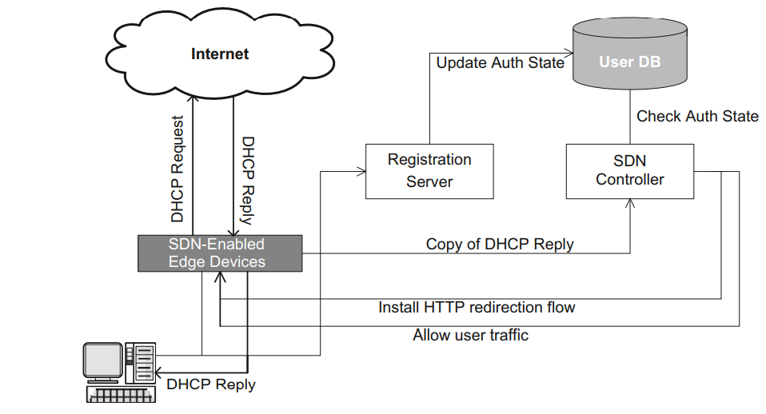
SDN-based captive portal-based application

Slide 17
SDN-based captive portal-based application
The network edge device is initially programmed to route ARP, DNS, and DHCP requests to the appropriate server.
In the figure, the end user connects to the network and makes a DHCP request to obtain an IP address.
When the DHCP reply is returned to the user, a copy is sent to the SDN controller.
Using the end-user MAC address as a lookup key, the controller consults the database of users.
If the user device is currently registered, it is allowed into the network.
If it is not, then OpenFlow rules are programmed to forward that user’s HTTP traffic to the controller.
When the unauthenticated user’s HTTP traffic is received at the controller, that web session is redirected to the captive portal web server.
After completing the user authentication or device registration, the controller updates the user’s flow(s) so that the packets will be allowed into the network.

Slide 18
Sentinel – SDN Application
HP currently offers a commercial SDN application called Sentinel that provides secure BYOD access.
The approach of securing the network from end-user infection by installing anti-malware software on end-user devices is not viable in the BYOD case since they are not under the control of the network administration.
The Sentinel SDN application provides a solution by turning the entire network infrastructure into a security-enforcement device using mechanisms that are hardened and more sophisticated versions of the basic methods for campus security.
Sentinel is an SDN application (Black list Technology) that works with HP’s Tipping Point threat database to secure and apply policy to the intranet as follows:
1. Identify botnets on the intranet and neutralize them by blocking DNS requests and IP connections to their botnet masters in the Internet.
2. Identify and prevent users or machines from accessing infected or prohibited sites on the Internet by monitoring and blocking DNS requests and IP connections
3. Identify and quarantine infected machines on the intranet so that they can be remediated.

Slide 19
SDN on Campus: Traffic Suppression
The unwanted traffic could be benign, such as service discovery multicasts, or it could be malicious, such as infected devices bringing viruses into the network.
With flow tables at the edge of the network, service discovery traffic can be captured by the edge device and forwarded to the controller.
The controller can then keep a repository of services and service requestors, which can be used to satisfy requests without having to forward all those multicasts upstream to flood the possibly overloaded network.
The ability to set policy and security for end users with highly granular flow-based mechanisms facilitates effective per-user firewalls.
One facet of a per-user firewall is an application known as a blacklist.
Blacklist technology blocks attempts by end users to access known malicious or harmful hostnames and IP addresses.
Traditional blacklist solutions rely on in-line appliances that snoop all traffic and attempt to trap and block attempts to reach these bad destinations.

Slide 20
SDN on Campus: Traffic Suppression
SDN is able to implement a blacklist solution without the insertion of additional appliances into the network.
This provides both CAPEX savings due to less network equipment and OPEX savings due to a network that is easier to administer.
An SDN application for blocking attempts to reach specific hostnames entails setting up flow table rules in edge devices to capture DNS requests and send them to the controller.
The SDN controller consults a database of undesirable hostnames and blocks the DNS request from being sent out when a blacklisted hostname is encountered.

Slide 21
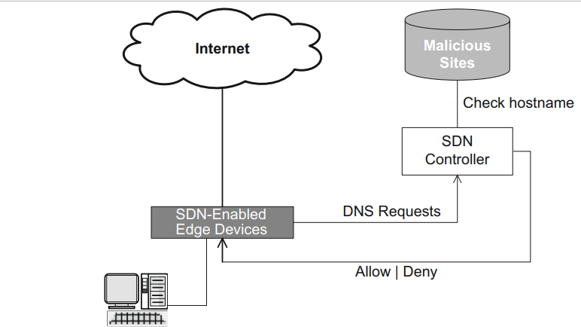
DNS Blacklist Application
The controller sets flows in the edge devices, directing them to forward all DNS requests to the controller.
When DNS requests arrive at the controller, the controller consults a local or remote database of known malicious sites.
If the result is that the hostname is clean, the controller returns the DNS request with instructions to the edge device to forward the packet as it normally would.
If the hostname is deemed unsafe, the controller instructs the edge device to drop the packet, denying the user access to that host.

Slide 22
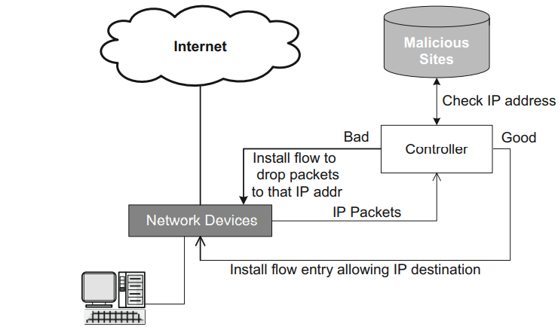
IP Address Blacklist Application

Slide 23
IP Address Blacklist Application
A savvy user can circumvent this first blacklist application if he/she knows the IP address of the destination host.
By specifying the IP address directly instead of the hostname, no DNS request is sent.
Figure shows a simple SDN implementation for this variant of the blacklist problem.
In this, packets with destination IP addresses of unknown virtue are forwarded to the controller, which inspects the packets and either allows the IP address (so that packets to and from that IP address will now automatically be allowed) or else the device is programmed to drop this and future packets sent to that bad address.
If the packet is allowed, the application will install a transient flow allowing requests to that destination IP address.
If destination IP address allow rules have aging timers that are too short, they will age out in between requests, and consequently, every time a destination is visited, there will be delay and overhead associated with verifying and allowing the packets to that destination.
If those rules have aging timers that are too long, the device runs the risk of being overloaded with flow entries, possibly even exceeding the maximum size of the flow table.

Slide 24
Hospitality Networks
Hospitality networks are found in hotels, airports, coffee shops, and fast-food restaurants among other places.
The primary end user in a hospitality network is a guest using the network either through the largesse of the establishment or through the purchase of a certain amount of time.
One class of the for-purchase situation is end users who have purchased connectivity for a certain duration, such as a month or a year, and who are thus able to connect to the network without a direct financial exchange each time they connect.
The application of SDN for captive portals in the campus applies similarly to hospitality networks.
In hospitality networks, the user is paying directly or indirectly for the access, so a corresponding form of identification will likely be involved in authenticating with the registration server.
These could include providing hotel room or credit card information.
Hospitality networks frequently offer WiFi access.

